Slide 1
Analyzing Drug Overdose Death In State of Connecticut

Slide 2
Introduction
During last 15 years, there has been a steady rise in death rates in the United States due to drug overdose.
The state of Connecticut shares this trend, having seen a around 3600 deaths between year 2012 to 2017.
Another report suggests accidental deaths due to drug abuse in 2016 has increased 25% compared to the death rate of previous year.
The rising problem of death due to drug overdose motivated our team to take up this project to conduct analysis and perform data mining activities so that these analysis can help to reduce the death rate and allocate required resources to most affected areas.

Slide 3
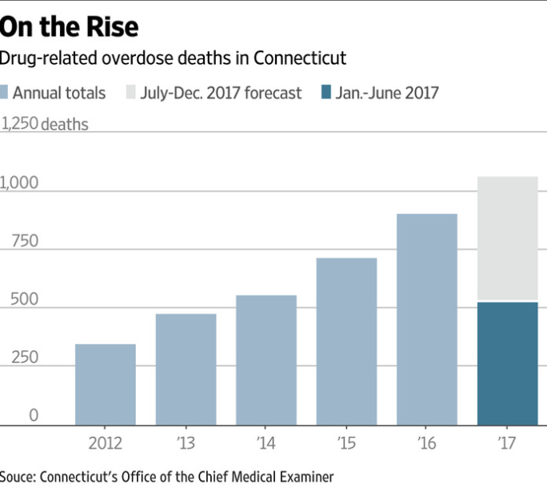
Introduction Cont..

Slide 4
Problem Statement and Goal
A substantial increase in the cases of accidental death due to drug overdose, in the state of Connecticut, over the last few years has caused detrimental effect on society.
Project goal is analyze the dataset of accidental death due to drug abuse in state of Connecticut to find patterns using data mining techniques.

Slide 5
Data Exploration
The data motivating for the study is taken from www.data.gov’s website from database Accidental Drug Related Deaths 2012-June 2017.
The data consists of 3,584 records and partitioned into 32 attributes.
Some of these attributes are age, race, gender, date of death, state ,city and county of residence and death, prognosis of incident and diagnosis of drug.
These attributes were numerical, and nominal types.

Slide 6
Data Exploration
We found that there were few insignificant attributes. For example, incident number is an attribute which is a unique identifier and used to index each record.
Incident number may be useful for the medical community to keep track of records, but it does not contribute to a model formation and hence is insignificant for data mining process.
There are other attributes such as state of residence and state of death, in which almost all of the records belong to Connecticut and so insignificant to data mining process.
As a result of these insignificant attributes pre-processing was performed. After which above mentioned fields were removed from dataset.

Slide 7
Data Pre-processing
The date of death attribute was split, to give two attributes month and year.
The date attribute needs to be fragmented in order to do a better comparison between datasets.
There are attributes like race, city of residence, and place of injury, which has some missing values and thus we filled it with unknown.
Finally, we are left with 3,581 records and 30 attributes, which was pre-processed further.

Slide 8
Pre-processing
Pre-processing did not just involved removing insignificant attributes but also replacing instances which did not suit the datamining process.
For example, in age we found that one of the record (number 781) has an unknown age attribute value and with the assumption that age is a discrete attribute, the age attribute value is replaced by a mode value i.e. 50.
Even though, if we have considered age attribute as a continuous attribute, the mean value would be approximately 50. Hence, 50 is a suitable value for the missing age value for the record.

Slide 9
Pre-processing
We converted numeric value of age and year attribute to a nominal value, so that clustering algorithms can be performed on it. Before converting to nominal field and post clustering, attributes value were displayed as 23.45(age) , 2013.55(year), which did not make any significance.
In addition, team has found that attributes like residence county, death county, death location should be removed since they do not contribute to the model building but affecting the accuracy.

Slide 10
Mining the Data
We have used two different learning algorithms for model building- clustering and classification.
Out initial thought was to perform classification algorithm for our dataset but soon we realized that for our dataset there is no potential class values and hence decided to perform clustering first.

Slide 11
Clustering
We initially started with Hierarchical cluster algorithm but it clustered 3579 records in one cluster and remaining 1 record in other cluster ; so then we moved to SimpleKMeans clustering algorithm.
Here we tried different values for K like 2,3,4,5,6,7,8,9 for learning curve and found that K=6 is an ideal K value because the curve has smooth changes after it.
This gave 6 clusters. which we later transformed into 3 values based on age, sex, race, and death city attributes and that acts as our class values for classification : Highly Vulnerable, Vulnerable, Less Vulnerable by grouping similar data points.

Slide 12
Classification
The major algorithms performed are
JRIP
IBK
Naive Bayes
We performed classification using 10-folds Cross Validation and percentage split.

Slide 13
Rules
Some of the rules generated are
(Death City = HARTFORD) and (Fentanyl = Present) => Severity=Vulnerable (17.0/3.0)
(EtOH = Present) and (Toxicity Report = Multiple Drug Toxicity) and (Oxycodone = Absent) and (Gender = Male) => Severity=Less Vulnerable (9.0/1.0)
(EtOH = Present) and (Death City = BRIDGEPORT) => Severity=Less Vulnerable (37.0/8.0)

Slide 14
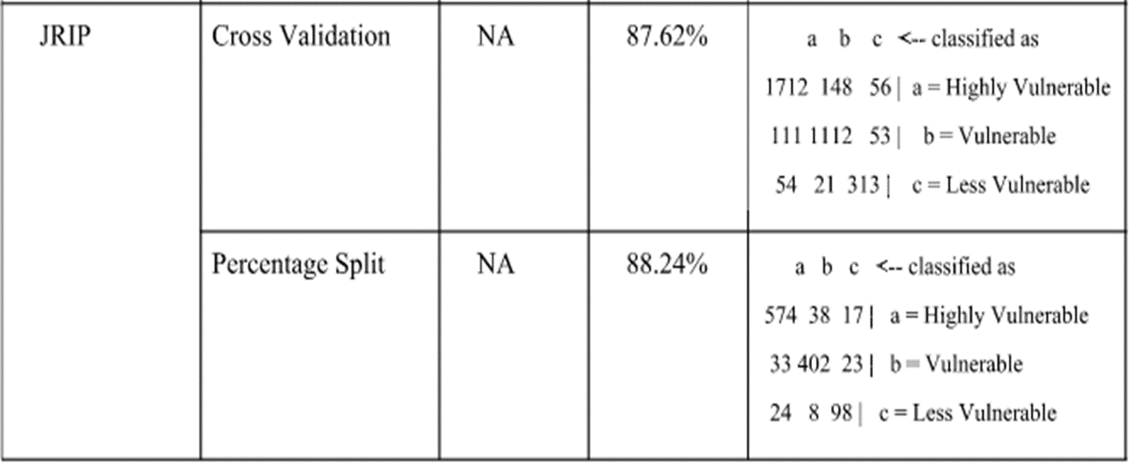
JRIP
Accuracies and Confusion Matrix

Slide 15
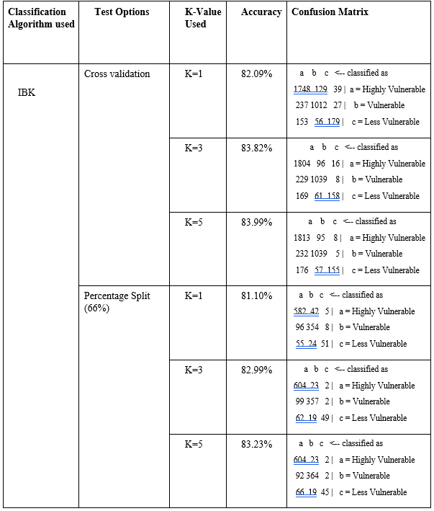
IBK
Accuracies and Confusion Matrix

Slide 16
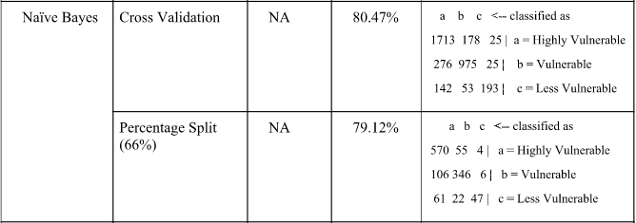
Naïve Bayes
Accuracies and Confusion Matrix

Slide 17
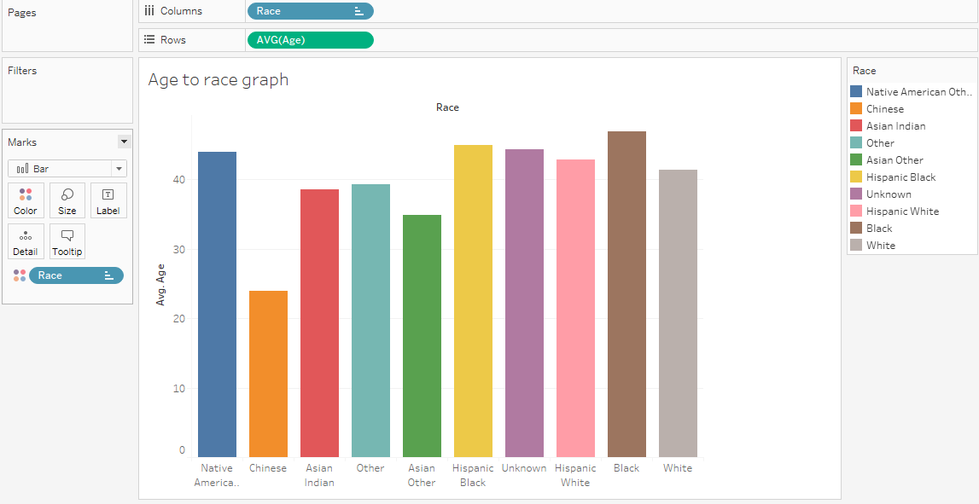
Tableau Analysis
Graphical representation of deaths based on race

Slide 18
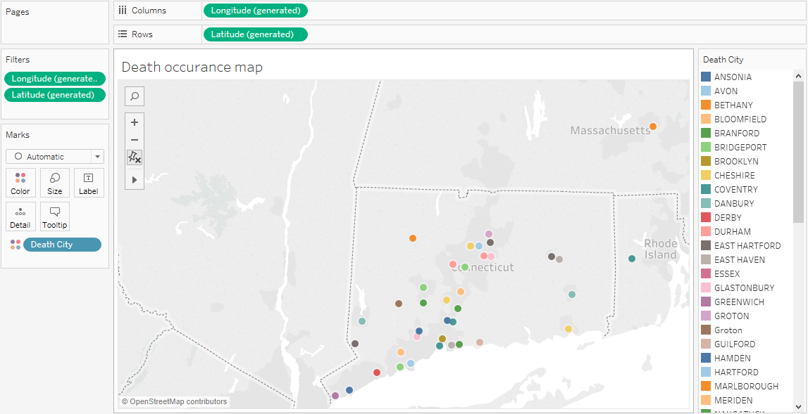
Tableau Analysis Cont..
City wise incident map

Slide 19
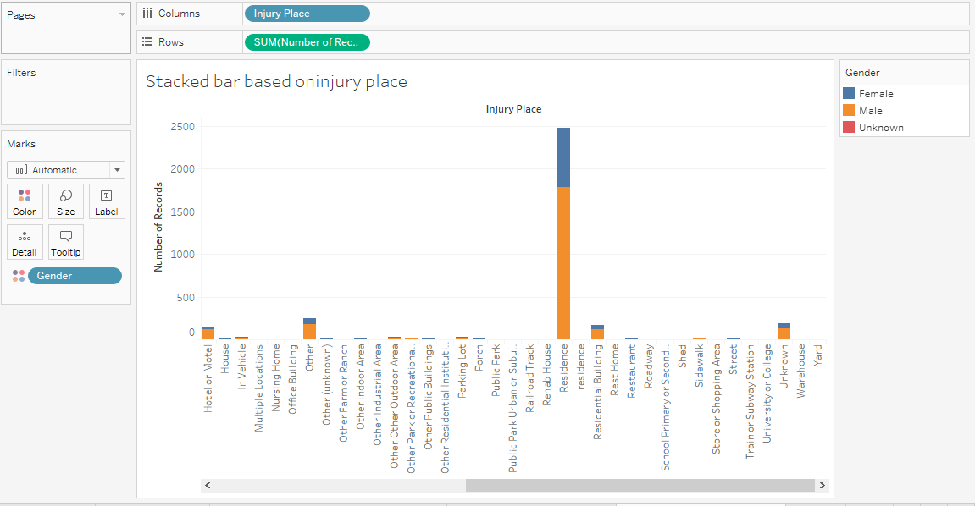
Tableau Analysis Cont..
Incident on death based on location injury took place

Slide 20
Conclusion
After performing IBK, Naïve Bayes, JRIP classification algorithms, we found that JRIP has the highest accuracy rate for cross-validation(87.62%) and percentage-split(88.24%) and it generates some useful rules for data mining analysis.
Weka generates a rule based on presence/absence of some of the drugs in victim’s body and on the toxicity report. For example, if the drug EtOH is found, Oxycodone is not found, and toxicity report says multiple drug toxicity, for male, Weka categorizes the severity of it to less Vulnerable.
The accuracy rate of Naïve Bayes algorithm is the list for both cross validation (80.47%) and percentage split (79.12%)

Slide 21
Pattern Discovered and Suitable Model
One of pattern found in different model is that most of the males between the age group of 26-50 years, who are the resident of city “Waterbury” are addicts of drugs “Heroine” and “Oxycodone”.
In dataset, there are very few numeric attribute (age and year) and most of the attributes are related to the presence/absence of various drugs in victim’s body. Hence, JRIP would be the best model, since it generates various rules related to the comparison of drug’s presence/absence along with relationship of them with different sex, age, and death city.

Slide 22
Future Work
Our data source does not have many numeric fields .Thus, for further action, our team will try to find and add more numeric attributes, that would make the analysis easier.
Other alternative is that our team may have to generate some numeric field out of the existing nominal fields such as creating a attribute like harm score for different types of drugs.
At the end of project analysis and model building we will generate a report and sent it to the police department and government, so that they can apply some strong rules to mitigate the issue of drug related deaths.

Slide 23
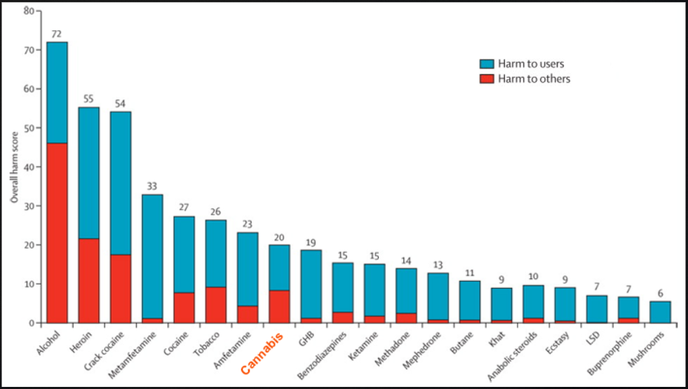
Standard Harm Score

Slide 24

Questions

